Slide 1
Deep Globe Building Detection Challenge
2018. 03. 20
Zhao Kang

Slide 2
Objective & Background
Automatically detecting buildings from satellite images
Binary segmentation problem to localize all building polygons in each area
Use same data and evaluation methods as SpaceNetChallenge, which has been held for 2 rounds.

Slide 3
Data: Input Files: Overview
City | Area (Sq. Km) | Building Labels (Polygons) | Amount (GB)
Vegas | 216 | 151367 | 23+7.9
Paris | 1030 | 23816 | 5.3+1.8
Shanghai | 1000 | 92015 | 23.4+7.7
Khartoum | 765 | 35503 | 4.7+1.6
Image size: 200m*200m
Image format: GeoTiff
Data collection: Digital Globe Worldview-3 Satellite
Data source: SpaceNet Building Dataset
Data downloading: Amazon Online Service:
aws s3 ls s3://spacenet-dataset/SpaceNet_Buildings_Dataset_Round2/

Slide 4
Data: Input Files: Satellite Images
4 different types:
PAN: panchromatic (single channel, 16-bit grayscale, ~30 cm resolution)
MUL: 8-band multi-channel (8*16-bit, ~1.2m resolution).
RGB-PanSharpen: pan-sharpened version of Red-Green-Blue bands from the multispectral product (3 channels, 3*16-bit, ~30 cm resolution).
MUL-PanSharpen: pan-sharpened version of MUL (8 channels, 8*16 bit, ~30 cm resolution)

Slide 5
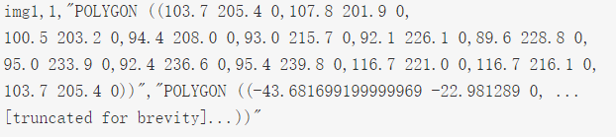
Data: Input Files: Ground Truth Files
CSV files Format:
ImageId: a string that uniquely identifies the image.
BuildingId: an integer that identifies a building in the image (1 or -1)
PolygonWKT_Pix: specifies the points of the shape that represents the building in Well Known Text format. The coordinate values represent pixels.
PolygonWKT_Geo: specifies the points of the same shape in geographical coordinates in {latitude, longitude, 0} triplets.

Slide 6

Output Files (Detection Result)
CSV files:
ImageId, BuildingId, PolygonWKT_Pix, Confidence
Confidence is a positive real number, higher numbers mean you are more confident that this building is indeed present. See the details of scoring for how this value is used.

Slide 7
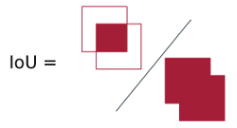
Evaluation Metric
IOU (Intersection over union)
true positive if IOU>0.5
false positive otherwise
F1 Score
F1 score = 2 * Precision * Recall / (Precision + Recall)

Slide 8
Important Dates
Date open: March 16th
Submission Deadline: April 30th, 6 pm (results and paper of 4 pages)
Competition ends: May 15th
Paper Notification: May 20th
Challenge Notification: May 25th
Deep Globe Workshop at CVPR: June 18th

Slide 9
Reference
http://deepglobe.org/challenge.html
https://github.com/SpaceNetChallenge
https://wwwtc.wpengine.com/spacenet
https://community.topcoder.com/longcontest/?module=ViewProblemStatement&rd=16892&pm=14551

